Slide 1





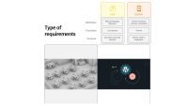

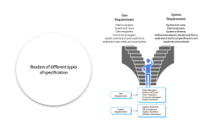
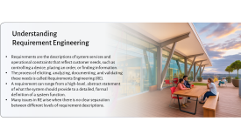

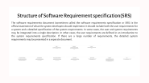
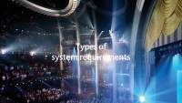
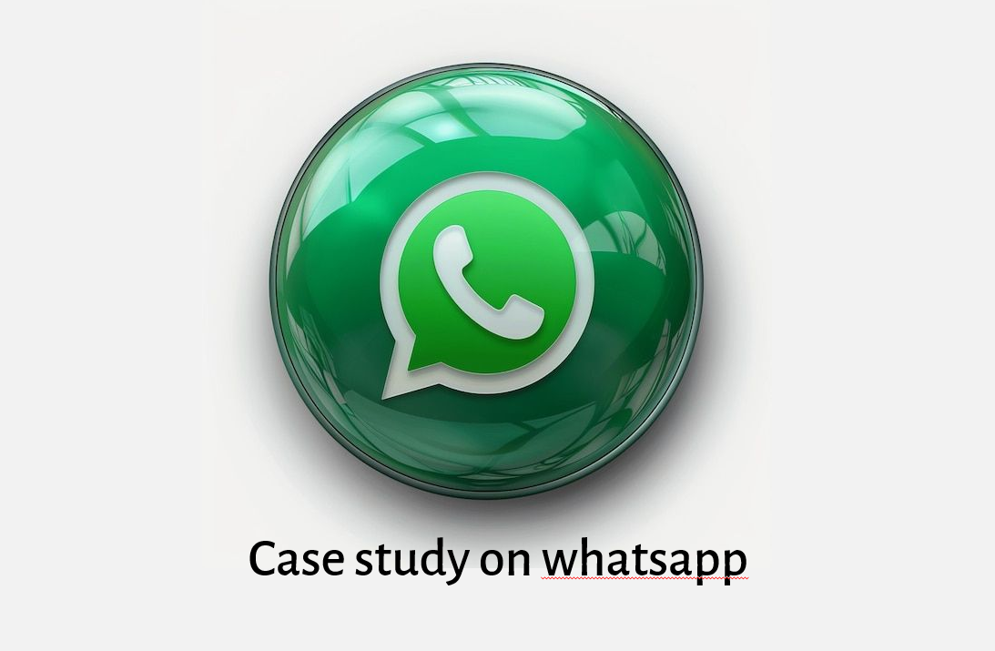
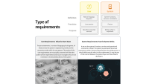
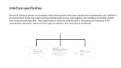

Understanding
Requirement Engineering
Exploring the Core Principles and Practices of Requirement Engineering in Software Development
-Goutham

Slide 2

Understanding
Requirement Engineering
Requirements are the descriptions of system services and operational constraints that reflect customer needs, such as controlling a device, placing an order, or finding information.
The process of eliciting, analyzing, documenting, and validating these needs is called Requirements Engineering (RE).
A requirement can range from a high-level, abstract statement of what the system should provide to a detailed, formal definition of a system function.
Many issues in RE arise when there is no clear separation between different levels of requirement descriptions.

Slide 3
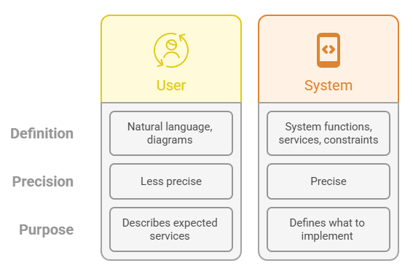
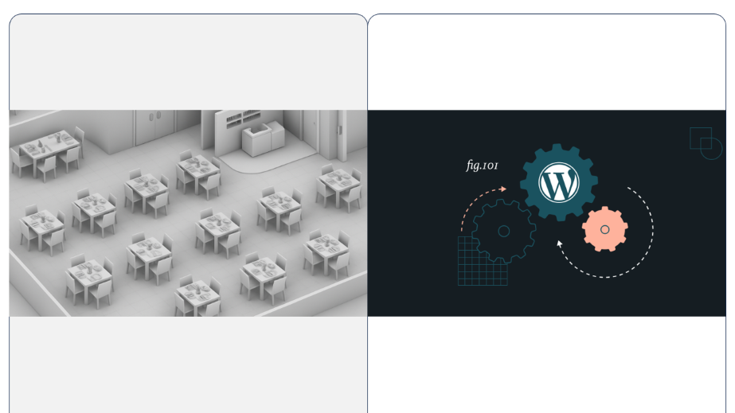
Type of requirements

Slide 4

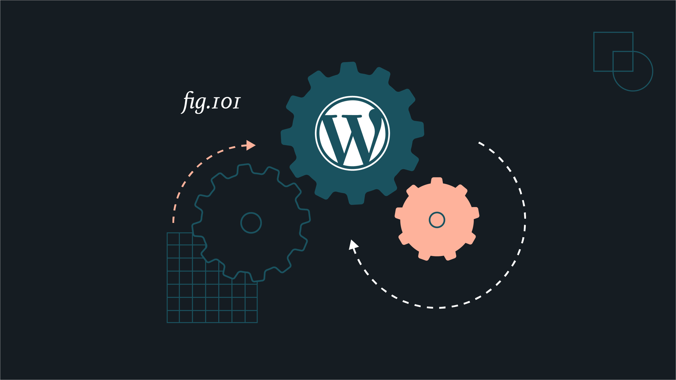
User Requirements: What the Users Want
System Requirements: How the System Works
They are statements, in a natural language plus diagrams, of what services the system is expected to provide and the constraints under which it must operate. The readers of the user requirements are not usually concerned with how the system will be implemented and may be managers who are not interested in the detailed facilities of the system.
It set out the system's functions, services and operational constraints in detail. The system requirements document (sometimes called a functional specification) should be precise. It should define exactly what is to be implemented. It may be part of the contract between the system buyer and the software developers

Slide 5
User Requirements: What the Users Want
They are statements, in a natural language plus diagrams, of what services the system is expected to provide and the constraints under which it must operate. The readers of the user requirements are not usually concerned with how the system will be implemented and may be managers who are not interested in the detailed facilities of the system.
System Requirements: How the System Works
It set out the system's functions, services and operational constraints in detail. The system requirements document (sometimes called a functional specification) should be precise. It should define exactly what is to be implemented. It may be part of the contract between the system buyer and the software developers

Slide 6

Case study on whatsapp

Slide 7
Case study on whatsapp

Slide 8



User+System Requirement
Online
Users want to send text messages instantly to contacts.
The system must implement a client-server architecture where messages are sent via WhatsApp servers and delivered within <200 ms under normal network conditions.
Users want to send images, videos, audio, and documents.
The system shall support multimedia file transfer up to a specific size limit (e.g., 100 MB), compress media, and use secure file storage servers.
Users want to make voice and video calls.
The system shall provide VoIP services using WebRTC protocol, ensuring low-latency communication with adaptive bitrate streaming.
Users want their messages to be private and secure.
The system must use end-to-end encryption (Signal Protocol with AES-256 encryption, Curve25519 keys) so only sender and receiver can read the messages.
Users want to know when their message is sent, delivered, and read.
The system shall maintain message status flags (sent , delivered , read blue) using server acknowledgments and read receipts.
Users want to create groups and broadcast messages.
The system shall maintain group metadata on servers (group ID, members list, permissions) and deliver messages to all group members simultaneously.
Users want to backup and restore chat history.
The system shall provide cloud backup integration (Google Drive/iCloud) with encrypted chat exports and scheduled backup functionality.

Slide 9
User+System Requirement
Online
Users want to send text messages instantly to contacts.
The system must implement a client-server architecture where messages are sent via WhatsApp servers and delivered within <200 ms under normal network conditions.
Users want to send images, videos, audio, and documents.
The system shall support multimedia file transfer up to a specific size limit (e.g., 100 MB), compress media, and use secure file storage servers.
Users want to make voice and video calls.
The system shall provide VoIP services using WebRTC protocol, ensuring low-latency communication with adaptive bitrate streaming.
Users want their messages to be private and secure.
The system must use end-to-end encryption (Signal Protocol with AES-256 encryption, Curve25519 keys) so only sender and receiver can read the messages.
Users want to know when their message is sent, delivered, and read.
The system shall maintain message status flags (sent , delivered , read blue) using server acknowledgments and read receipts.
Users want to create groups and broadcast messages.
The system shall maintain group metadata on servers (group ID, members list, permissions) and deliver messages to all group members simultaneously.
Users want to backup and restore chat history.
The system shall provide cloud backup integration (Google Drive/iCloud) with encrypted chat exports and scheduled backup functionality.

Slide 10
User+System Requirement
Online
Users want to send text messages instantly to contacts.
The system must implement a client-server architecture where messages are sent via WhatsApp servers and delivered within <200 ms under normal network conditions.
Users want to send images, videos, audio, and documents.
The system shall support multimedia file transfer up to a specific size limit (e.g., 100 MB), compress media, and use secure file storage servers.
Users want to make voice and video calls.
The system shall provide VoIP services using WebRTC protocol, ensuring low-latency communication with adaptive bitrate streaming.
Users want their messages to be private and secure.
The system must use end-to-end encryption (Signal Protocol with AES-256 encryption, Curve25519 keys) so only sender and receiver can read the messages.
Users want to know when their message is sent, delivered, and read.
The system shall maintain message status flags (sent , delivered , read blue) using server acknowledgments and read receipts.
Users want to create groups and broadcast messages.
The system shall maintain group metadata on servers (group ID, members list, permissions) and deliver messages to all group members simultaneously.
Users want to backup and restore chat history.
The system shall provide cloud backup integration (Google Drive/iCloud) with encrypted chat exports and scheduled backup functionality.

Slide 11
User+System Requirement
Online
Users want to send text messages instantly to contacts.
The system must implement a client-server architecture where messages are sent via WhatsApp servers and delivered within <200 ms under normal network conditions.
Users want to send images, videos, audio, and documents.
The system shall support multimedia file transfer up to a specific size limit (e.g., 100 MB), compress media, and use secure file storage servers.
Users want to make voice and video calls.
The system shall provide VoIP services using WebRTC protocol, ensuring low-latency communication with adaptive bitrate streaming.
Users want their messages to be private and secure.
The system must use end-to-end encryption (Signal Protocol with AES-256 encryption, Curve25519 keys) so only sender and receiver can read the messages.
Users want to know when their message is sent, delivered, and read.
The system shall maintain message status flags (sent , delivered , read blue) using server acknowledgments and read receipts.
Users want to create groups and broadcast messages.
The system shall maintain group metadata on servers (group ID, members list, permissions) and deliver messages to all group members simultaneously.
Users want to backup and restore chat history.
The system shall provide cloud backup integration (Google Drive/iCloud) with encrypted chat exports and scheduled backup functionality.

Slide 12
User+System Requirement
Online
Users want to send text messages instantly to contacts.
The system must implement a client-server architecture where messages are sent via WhatsApp servers and delivered within <200 ms under normal network conditions.
Users want to send images, videos, audio, and documents.
The system shall support multimedia file transfer up to a specific size limit (e.g., 100 MB), compress media, and use secure file storage servers.
Users want to make voice and video calls.
The system shall provide VoIP services using WebRTC protocol, ensuring low-latency communication with adaptive bitrate streaming.
Users want their messages to be private and secure.
The system must use end-to-end encryption (Signal Protocol with AES-256 encryption, Curve25519 keys) so only sender and receiver can read the messages.
Users want to know when their message is sent, delivered, and read.
The system shall maintain message status flags (sent , delivered , read blue) using server acknowledgments and read receipts.
Users want to create groups and broadcast messages.
The system shall maintain group metadata on servers (group ID, members list, permissions) and deliver messages to all group members simultaneously.
Users want to backup and restore chat history.
The system shall provide cloud backup integration (Google Drive/iCloud) with encrypted chat exports and scheduled backup functionality.

Slide 13
User+System Requirement
Users want to send text messages instantly to contacts.
Online
The system must implement a client-server architecture where messages are sent via WhatsApp servers and delivered within <200 ms under normal network conditions.
Users want to send images, videos, audio, and documents.
The system shall support multimedia file transfer up to a specific size limit (e.g., 100 MB), compress media, and use secure file storage servers.
Users want to make voice and video calls.
The system shall provide VoIP services using WebRTC protocol, ensuring low-latency communication with adaptive bitrate streaming.
Users want their messages to be private and secure.
The system must use end-to-end encryption (Signal Protocol with AES-256 encryption, Curve25519 keys) so only sender and receiver can read the messages.
Users want to know when their message is sent, delivered, and read.
The system shall maintain message status flags (sent , delivered , read blue) using server acknowledgments and read receipts.
Users want to create groups and broadcast messages.
The system shall maintain group metadata on servers (group ID, members list, permissions) and deliver messages to all group members simultaneously.
Users want to backup and restore chat history.
The system shall provide cloud backup integration (Google Drive/iCloud) with encrypted chat exports and scheduled backup functionality.

Slide 14
Users want to send text messages instantly to contacts.
The system must implement a client-server architecture where messages are sent via WhatsApp servers and delivered within <200 ms under normal network conditions.
User+System Requirement
Online
Users want to send images, videos, audio, and documents.
The system shall support multimedia file transfer up to a specific size limit (e.g., 100 MB), compress media, and use secure file storage servers.
Users want to make voice and video calls.
The system shall provide VoIP services using WebRTC protocol, ensuring low-latency communication with adaptive bitrate streaming.
Users want their messages to be private and secure.
The system must use end-to-end encryption (Signal Protocol with AES-256 encryption, Curve25519 keys) so only sender and receiver can read the messages.
Users want to know when their message is sent, delivered, and read.
The system shall maintain message status flags (sent , delivered , read blue) using server acknowledgments and read receipts.
Users want to create groups and broadcast messages.
The system shall maintain group metadata on servers (group ID, members list, permissions) and deliver messages to all group members simultaneously.
Users want to backup and restore chat history.
The system shall provide cloud backup integration (Google Drive/iCloud) with encrypted chat exports and scheduled backup functionality.

Slide 15
Users want to send text messages instantly to contacts.
The system must implement a client-server architecture where messages are sent via WhatsApp servers and delivered within <200 ms under normal network conditions.
Users want to send images, videos, audio, and documents.
User+System Requirement
The system shall support multimedia file transfer up to a specific size limit (e.g., 100 MB), compress media, and use secure file storage servers.
Online
Users want to make voice and video calls.
The system shall provide VoIP services using WebRTC protocol, ensuring low-latency communication with adaptive bitrate streaming.
Users want their messages to be private and secure.
The system must use end-to-end encryption (Signal Protocol with AES-256 encryption, Curve25519 keys) so only sender and receiver can read the messages.
Users want to know when their message is sent, delivered, and read.
The system shall maintain message status flags (sent , delivered , read blue) using server acknowledgments and read receipts.
Users want to create groups and broadcast messages.
The system shall maintain group metadata on servers (group ID, members list, permissions) and deliver messages to all group members simultaneously.
Users want to backup and restore chat history.
The system shall provide cloud backup integration (Google Drive/iCloud) with encrypted chat exports and scheduled backup functionality.

Slide 16
Users want to send text messages instantly to contacts.
The system must implement a client-server architecture where messages are sent via WhatsApp servers and delivered within <200 ms under normal network conditions.
Users want to send images, videos, audio, and documents.
The system shall support multimedia file transfer up to a specific size limit (e.g., 100 MB), compress media, and use secure file storage servers.
User+System Requirement
Online
Users want to make voice and video calls.
The system shall provide VoIP services using WebRTC protocol, ensuring low-latency communication with adaptive bitrate streaming.
Users want their messages to be private and secure.
The system must use end-to-end encryption (Signal Protocol with AES-256 encryption, Curve25519 keys) so only sender and receiver can read the messages.
Users want to know when their message is sent, delivered, and read.
The system shall maintain message status flags (sent , delivered , read blue) using server acknowledgments and read receipts.
Users want to create groups and broadcast messages.
The system shall maintain group metadata on servers (group ID, members list, permissions) and deliver messages to all group members simultaneously.
Users want to backup and restore chat history.
The system shall provide cloud backup integration (Google Drive/iCloud) with encrypted chat exports and scheduled backup functionality.

Slide 17
Users want to send text messages instantly to contacts.
The system must implement a client-server architecture where messages are sent via WhatsApp servers and delivered within <200 ms under normal network conditions.
Users want to send images, videos, audio, and documents.
The system shall support multimedia file transfer up to a specific size limit (e.g., 100 MB), compress media, and use secure file storage servers.
Users want to make voice and video calls.
The system shall provide VoIP services using WebRTC protocol, ensuring low-latency communication with adaptive bitrate streaming.
User+System Requirement
Online
Users want their messages to be private and secure.
The system must use end-to-end encryption (Signal Protocol with AES-256 encryption, Curve25519 keys) so only sender and receiver can read the messages.
Users want to know when their message is sent, delivered, and read.
The system shall maintain message status flags (sent , delivered , read blue) using server acknowledgments and read receipts.
Users want to create groups and broadcast messages.
The system shall maintain group metadata on servers (group ID, members list, permissions) and deliver messages to all group members simultaneously.
Users want to backup and restore chat history.
The system shall provide cloud backup integration (Google Drive/iCloud) with encrypted chat exports and scheduled backup functionality.

Slide 18
Users want to send text messages instantly to contacts.
The system must implement a client-server architecture where messages are sent via WhatsApp servers and delivered within <200 ms under normal network conditions.
Users want to send images, videos, audio, and documents.
The system shall support multimedia file transfer up to a specific size limit (e.g., 100 MB), compress media, and use secure file storage servers.
Users want to make voice and video calls.
The system shall provide VoIP services using WebRTC protocol, ensuring low-latency communication with adaptive bitrate streaming.
User+System Requirement
Online
Users want their messages to be private and secure.
The system must use end-to-end encryption (Signal Protocol with AES-256 encryption, Curve25519 keys) so only sender and receiver can read the messages.
Users want to know when their message is sent, delivered, and read.
The system shall maintain message status flags (sent , delivered , read blue) using server acknowledgments and read receipts.
Users want to create groups and broadcast messages.
The system shall maintain group metadata on servers (group ID, members list, permissions) and deliver messages to all group members simultaneously.
Users want to backup and restore chat history.
The system shall provide cloud backup integration (Google Drive/iCloud) with encrypted chat exports and scheduled backup functionality.

Slide 19
Users want to send text messages instantly to contacts.
The system must implement a client-server architecture where messages are sent via WhatsApp servers and delivered within <200 ms under normal network conditions.
Users want to send images, videos, audio, and documents.
The system shall support multimedia file transfer up to a specific size limit (e.g., 100 MB), compress media, and use secure file storage servers.
Users want to make voice and video calls.
The system shall provide VoIP services using WebRTC protocol, ensuring low-latency communication with adaptive bitrate streaming.
Users want their messages to be private and secure.
The system must use end-to-end encryption (Signal Protocol with AES-256 encryption, Curve25519 keys) so only sender and receiver can read the messages.
User+System Requirement
Online
Users want to know when their message is sent, delivered, and read.
The system shall maintain message status flags (sent , delivered , read blue) using server acknowledgments and read receipts.
Users want to create groups and broadcast messages.
The system shall maintain group metadata on servers (group ID, members list, permissions) and deliver messages to all group members simultaneously.
Users want to backup and restore chat history.
The system shall provide cloud backup integration (Google Drive/iCloud) with encrypted chat exports and scheduled backup functionality.

Slide 20
Users want to send text messages instantly to contacts.
The system must implement a client-server architecture where messages are sent via WhatsApp servers and delivered within <200 ms under normal network conditions.
Users want to send images, videos, audio, and documents.
The system shall support multimedia file transfer up to a specific size limit (e.g., 100 MB), compress media, and use secure file storage servers.
Users want to make voice and video calls.
The system shall provide VoIP services using WebRTC protocol, ensuring low-latency communication with adaptive bitrate streaming.
Users want their messages to be private and secure.
The system must use end-to-end encryption (Signal Protocol with AES-256 encryption, Curve25519 keys) so only sender and receiver can read the messages.
User+System Requirement
Online
Users want to know when their message is sent, delivered, and read.
The system shall maintain message status flags (sent , delivered , read blue) using server acknowledgments and read receipts.
Users want to create groups and broadcast messages.
The system shall maintain group metadata on servers (group ID, members list, permissions) and deliver messages to all group members simultaneously.
Users want to backup and restore chat history.
The system shall provide cloud backup integration (Google Drive/iCloud) with encrypted chat exports and scheduled backup functionality.

Slide 21
Users want to send text messages instantly to contacts.
The system must implement a client-server architecture where messages are sent via WhatsApp servers and delivered within <200 ms under normal network conditions.
Users want to send images, videos, audio, and documents.
The system shall support multimedia file transfer up to a specific size limit (e.g., 100 MB), compress media, and use secure file storage servers.
Users want to make voice and video calls.
The system shall provide VoIP services using WebRTC protocol, ensuring low-latency communication with adaptive bitrate streaming.
Users want their messages to be private and secure.
The system must use end-to-end encryption (Signal Protocol with AES-256 encryption, Curve25519 keys) so only sender and receiver can read the messages.
Users want to know when their message is sent, delivered, and read.
User+System Requirement
Online
The system shall maintain message status flags (sent , delivered , read blue) using server acknowledgments and read receipts.
Users want to create groups and broadcast messages.
The system shall maintain group metadata on servers (group ID, members list, permissions) and deliver messages to all group members simultaneously.
Users want to backup and restore chat history.
The system shall provide cloud backup integration (Google Drive/iCloud) with encrypted chat exports and scheduled backup functionality.

Slide 22


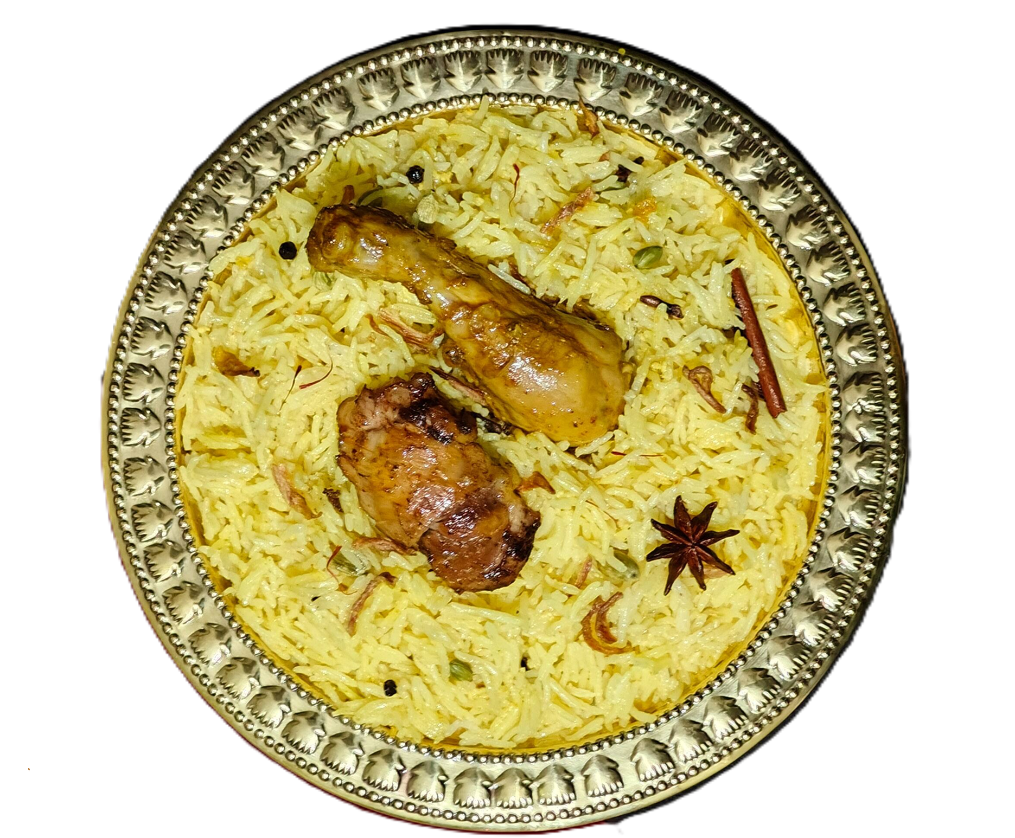
Case study
on
Zomato

Slide 23
User Specifications (What the user wants)
Account Creation & Login
User should be able to register/login with email, phone, or social login.
Search Restaurants
User should be able to search by restaurant name, cuisine, or location.
Browse Menu
User should be able to view restaurant menus with prices and images.
Place Order
User should be able to order food and customize items (e.g., add toppings).
Real-time Tracking
User should be able to track order status and delivery partner’s location.
Payment Options
User should be able to pay via UPI, cards, wallets, or cash on delivery.
Ratings & Reviews
User should be able to rate restaurants and write reviews.
System Specifications (How the system makes it possible)
Case study
on
Zomato
Authentication System
Secure login with OAuth/OTP verification.
Restaurant Database
Store details of restaurants, menus, ratings, and availability.
Search & Filtering Engine
Fast queries to find restaurants by cuisine, location, or cost.
Order Management System
Tracks order from placement → restaurant preparation → delivery.
GPS & Maps Integration
Real-time location tracking of delivery partner.
Payment Gateway
Integration with UPI, credit/debit cards, wallets, and COD support.
Notification System
Push notifications for updates via FCM/APNs.

Slide 24
User Specifications (What the user wants)
Account Creation & Login
User should be able to register/login with email, phone, or social login.
Search Restaurants
User should be able to search by restaurant name, cuisine, or location.
Browse Menu
User should be able to view restaurant menus with prices and images.
Place Order
User should be able to order food and customize items (e.g., add toppings).
Real-time Tracking
User should be able to track order status and delivery partner’s location.
Payment Options
User should be able to pay via UPI, cards, wallets, or cash on delivery.
Ratings & Reviews
User should be able to rate restaurants and write reviews.
System Specifications (How the system makes it possible)
Authentication System
Secure login with OAuth/OTP verification.
Restaurant Database
Store details of restaurants, menus, ratings, and availability.
Search & Filtering Engine
Fast queries to find restaurants by cuisine, location, or cost.
Order Management System
Tracks order from placement → restaurant preparation → delivery.
GPS & Maps Integration
Real-time location tracking of delivery partner.
Payment Gateway
Integration with UPI, credit/debit cards, wallets, and COD support.
Notification System
Push notifications for updates via FCM/APNs.
Case study
on
Zomato

Slide 25

User Specifications (What the user wants)
Account Creation & Login
User should be able to register/login with email, phone, or social login.
Search Restaurants
User should be able to search by restaurant name, cuisine, or location.
Browse Menu
User should be able to view restaurant menus with prices and images.
Place Order
User should be able to order food and customize items (e.g., add toppings).
Real-time Tracking
User should be able to track order status and delivery partner’s location.
Payment Options
User should be able to pay via UPI, cards, wallets, or cash on delivery.
Ratings & Reviews
User should be able to rate restaurants and write reviews.
Case study
on
Zomato
Authentication System
Secure login with OAuth/OTP verification.
Restaurant Database
Store details of restaurants, menus, ratings, and availability.
Search & Filtering Engine
Fast queries to find restaurants by cuisine, location, or cost.
Order Management System
Tracks order from placement → restaurant preparation → delivery.
GPS & Maps Integration
Real-time location tracking of delivery partner.
Payment Gateway
Integration with UPI, credit/debit cards, wallets, and COD support.
Notification System
Push notifications for updates via FCM/APNs.
System Specifications (How the system makes it possible)

Slide 26
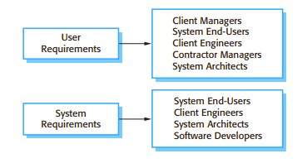
User
Requirements
System
Requirements
Client managers,
System end-users,
Client engineers,
Contractor managers,
System architects should read this to
understand user needs and expectations.
System end-users,
Client engineers,
System architects,
Software developers should read this to understand technical specifications and implementation details
Readers of different types of specification

Slide 27
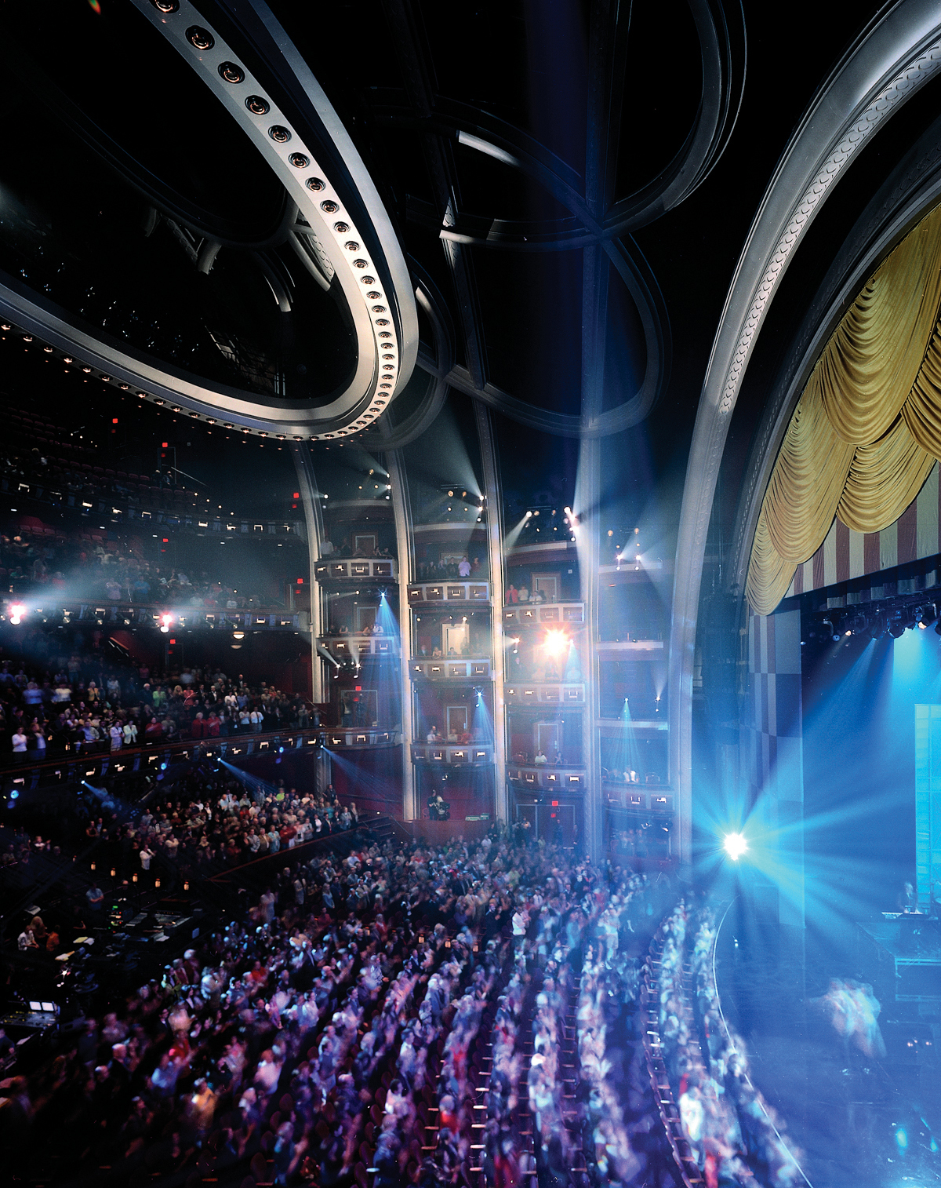
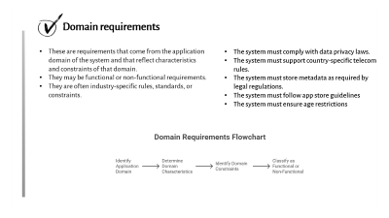
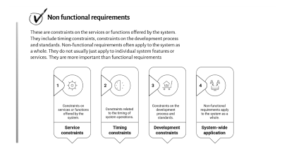
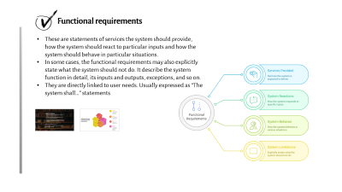
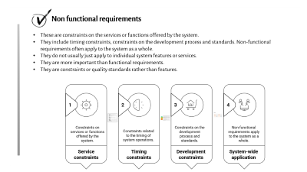
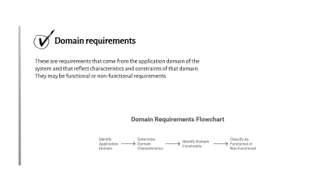
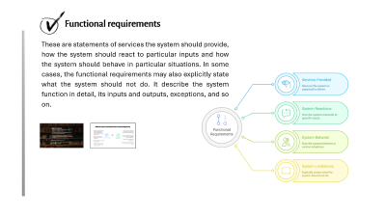
Types of system requirements

Slide 28
Types of system requirements

Slide 29

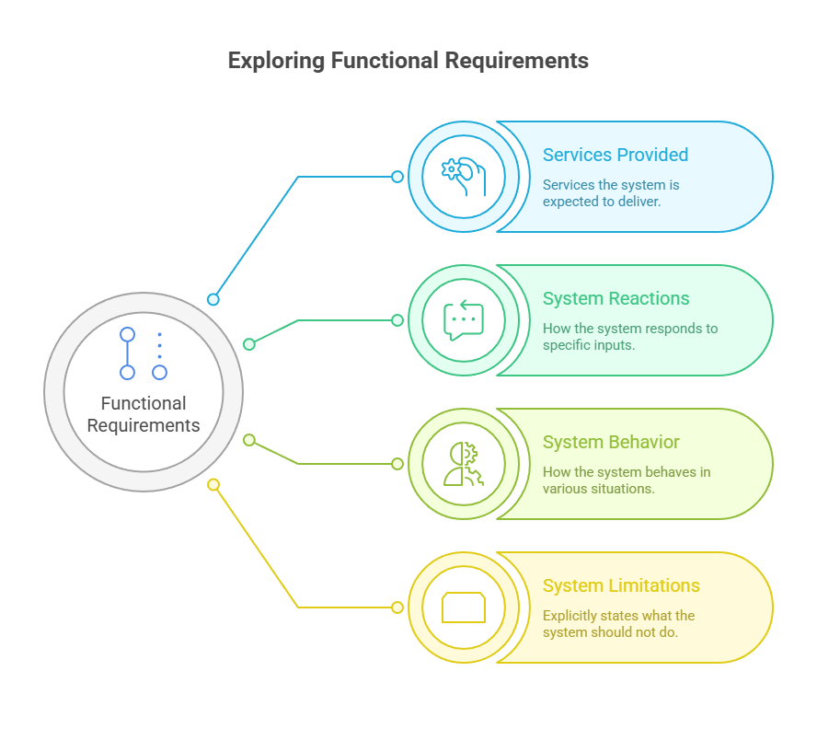


Functional requirements
These are statements of services the system should provide, how the system should react to particular inputs and how the system should behave in particular situations.
In some cases, the functional requirements may also explicitly state what the system should not do. It describe the system function in detail, its inputs and outputs, exceptions, and so on.
They are directly linked to user needs. Usually expressed as “The system shall…” statements

Slide 30

Example of Central city library:
The user shall be able to search either all of the initial set of databases or select a subset from it.
The system shall provide appropriate viewers for the user to read documents in the document store.
Every order shall be allocated a unique identifier (ORDER_iD), which the user shall be able to copy to the account's permanent storage area.
Problem: Imprecision in requirement
It should be complete and consistent(Requirements should not have contradictory meaning)

Slide 31
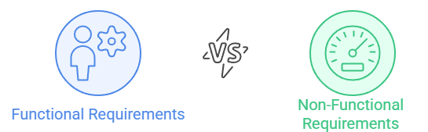
Difference between Functional and Non-Functional Requirement
A high-level, natural language statement (with diagrams if needed) describing what services or features the system should provide.
Written for end-users and customers (non-technical stakeholders).
Focuses on what the user expects from the system.
Example: “The system should allow students to log in using their university ID.”
A type of system constraint that specifies how the system should behave rather than what it should do.
Defines quality attributes such as performance, security, reliability, usability, scalability, etc.
Written in a more technical and measurable way.
Example: “The login process should take less than 2 seconds for 95% of users.”

Slide 32
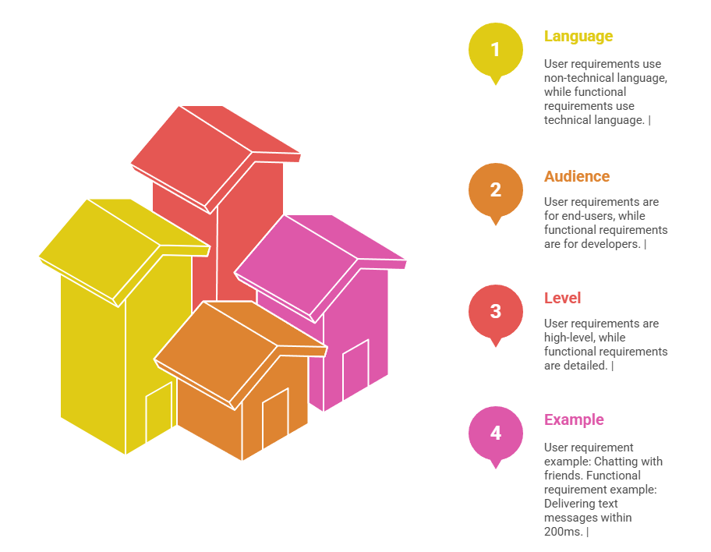
Difference between Functional and User requirements

Slide 33
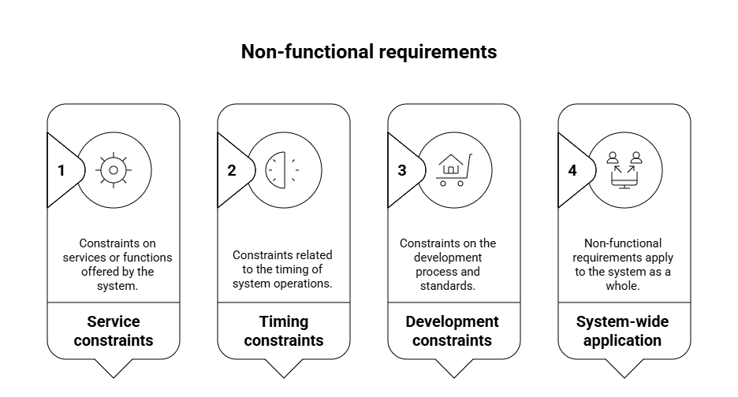
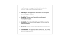
Non functional requirements
These are constraints on the services or functions offered by the system.
They include timing constraints, constraints on the development process and standards. Non-functional requirements often apply to the system as a whole.
They do not usually just apply to individual system features or services.
They are more important than functional requirements.
They are constraints or quality standards rather than features.

Slide 34
Performance: Messages should be delivered within 200ms under normal network conditions.
Security: All messages must use end-to-end encryption with the Signal Protocol.
Usability: The app must be intuitive and support multiple languages.
Scalability: The system should support billions of active users worldwide.
Reliability: 99.99% server uptime for messaging services.
Compatibility: The app must work on Android, iOS, Web, and Desktop platforms.

Slide 35
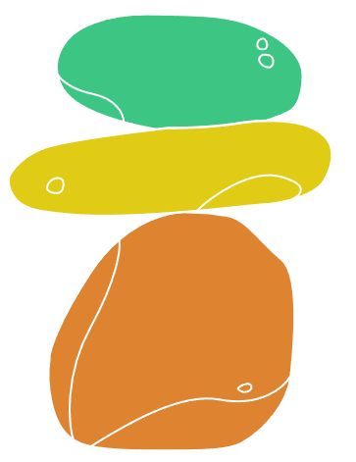
A common problem with non-functional requirements is that they can be difficult to verify. Users or customers often state these requirements as general goals such as ease of use, the ability of the system to recover from failure or rapid user response. These vague goals cause problems for system developers as they leave scope for interpretation and subsequent dispute once the system is delivered.
For example, the following system goal is typical of how a manager might express usability requirements:
The system should be easy to use by medical staff and should be organized in such a way that user errors are minimized.
It can be rewritten to show how the goal could be expressed as a ‘testable’ nonfunctional requirement. It is impossible to objectively verify the system goal, but in the description below you can at least include software instrumentation to count the errors made by users when they are testing the system.
Medical staff shall be able to use all the system functions after four hours of training. After this training, the average number of errors made by experienced users shall not exceed two per hour of system use.
Whenever possible, you should write non-functional requirements quantitatively so that they can be objectively tested.

Slide 36
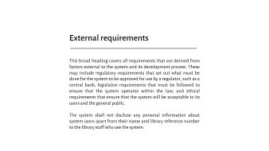
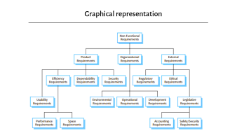
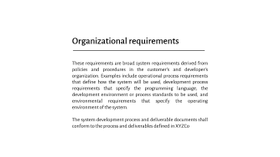
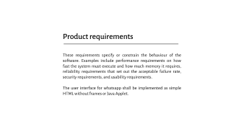
Type of NFR

Slide 37
Product requirements
These requirements specify or constrain the behaviour of the software. Examples include performance requirements on how fast the system must execute and how much memory it requires, reliability requirements that set out the acceptable failure rate, security requirements, and usability requirements.
The user interface for whatsapp shall be implemented as simple HTML without frames or Java Applet.

Slide 38
Organizational requirements
These requirements are broad system requirements derived from policies and procedures in the customer’s and developer’s organization. Examples include operational process requirements that define how the system will be used, development process requirements that specify the programming language, the development environment or process standards to be used, and environmental requirements that specify the operating environment of the system.
The system development process and deliverable documents shall conform to the process and deliverables defined in XYZCo

Slide 39
External requirements
This broad heading covers all requirements that are derived from factors external to the system and its development process. These may include regulatory requirements that set out what must be done for the system to be approved for use by a regulator, such as a central bank; legislative requirements that must be followed to ensure that the system operates within the law; and ethical requirements that ensure that the system will be acceptable to its users and the general public.
The system shall not disclose any personal information about system users apart from their name and library reference number to the library staff who use the system

Slide 40
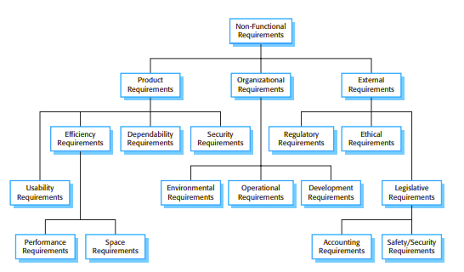
Graphical representation

Slide 41
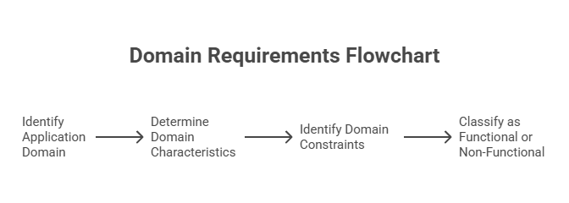
Domain requirements
These are requirements that come from the application domain of the system and that reflect characteristics and constraints of that domain.
They may be functional or non-functional requirements.
They are often industry-specific rules, standards, or constraints.
The system must comply with data privacy laws.
The system must support country-specific telecom rules.
The system must store metadata as required by legal regulations.
The system must follow app store guidelines
The system must ensure age restrictions

Slide 42

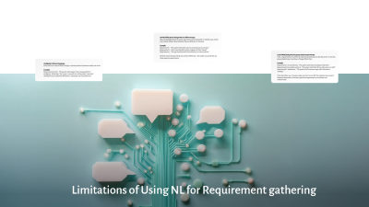
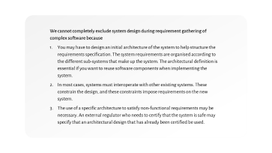
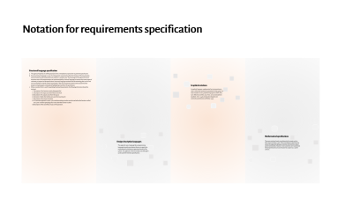
Software requirements
Ideally, the system requirements should simply describe the external behaviour of the system and its operational constraints. They should not be concerned with how the system should be designed or implemented.

Slide 43
We cannot completely exclude system design during requirement gathering of complex software because
You may have to design an initial architecture of the system to help structure the requirements specification. The system requirements are organised according to the different sub-systems that make up the system. The architectural definition is essential if you want to reuse software components when implementing the system.
In most cases, systems must interoperate with other existing systems. These constrain the design, and these constraints impose requirements on the new system.
The use of a specific architecture to satisfy non-functional requirements may be necessary. An external regulator who needs to certify that the system is safe may specify that an architectural design that has already been certified be used.

Slide 44

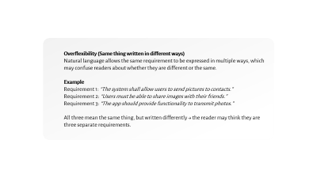
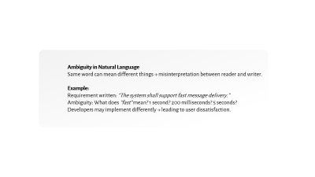
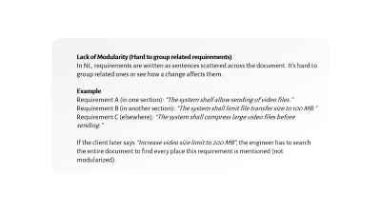
Limitations of Using NL for Requirement gathering

Slide 45
Ambiguity in Natural Language
Same word can mean different things → misinterpretation between reader and writer.
Example:
Requirement written: “The system shall support fast message delivery.”
Ambiguity: What does “fast” mean? 1 second? 200 milliseconds? 5 seconds?
Developers may implement differently → leading to user dissatisfaction.

Slide 46
Overflexibility (Same thing written in different ways)
Natural language allows the same requirement to be expressed in multiple ways, which may confuse readers about whether they are different or the same.
Example
Requirement 1: “The system shall allow users to send pictures to contacts.”
Requirement 2: “Users must be able to share images with their friends.”
Requirement 3: “The app should provide functionality to transmit photos.”
All three mean the same thing, but written differently → the reader may think they are three separate requirements.

Slide 47
Lack of Modularity (Hard to group related requirements)
In NL, requirements are written as sentences scattered across the document. It’s hard to group related ones or see how a change affects them.
Example
Requirement A (in one section): “The system shall allow sending of video files.”
Requirement B (in another section): “The system shall limit file transfer size to 100 MB.”
Requirement C (elsewhere): “The system shall compress large video files before sending.”
If the client later says “Increase video size limit to 200 MB”, the engineer has to search the entire document to find every place this requirement is mentioned (not modularized).

Slide 48
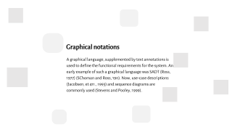
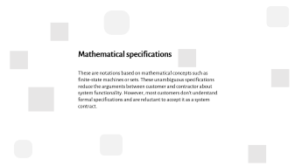
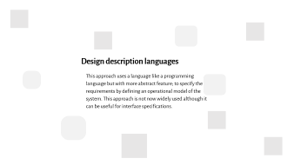
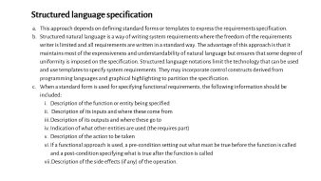
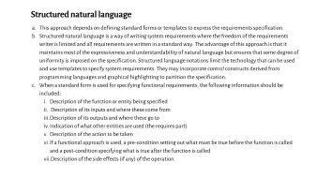
Notation for requirements specification

Slide 49
Structured language specification
This approach depends on defining standard forms or templates to express the requirements specification.
Structured natural language is a way of writing system requirements where the freedom of the requirements writer is limited and all requirements are written in a standard way. The advantage of this approach is that it maintains most of the expressiveness and understandability of natural language but ensures that some degree of uniformity is imposed on the specification. Structured language notations limit the technology that can be used and use templates to specify system requirements. They may incorporate control constructs derived from programming languages and graphical highlighting to partition the specification.
When a standard form is used for specifying functional requirements, the following information should be included:
Description of the function or entity being specified
Description of its inputs and where these come from
Description of its outputs and where these go to
Indication of what other entities are used (the requires part)
Description of the action to be taken
If a functional approach is used, a pre-condition setting out what must be true before the function is called and a post-condition specifying what is true after the function is called
Description of the side effects (if any) of the operation.
Function: Send Message
Inputs: Text typed by the user in chat box
Source of Input: User typing on mobile keyboard
Outputs: Message delivered to recipient’s chat window
Destination of Output: Recipient’s device
Requires: Active internet connection, recipient registered on WhatsApp
Action: Encrypt message, send via WhatsApp server, deliver to recipient
Pre-condition: User must be logged in
Post-condition: Recipient receives the message and delivery status is updated
Side-effects: Message stored in local chat history

Slide 50
Structured natural language
This approach depends on defining standard forms or templates to express the requirements specification.
Structured natural language is a way of writing system requirements where the freedom of the requirements writer is limited and all requirements are written in a standard way. The advantage of this approach is that it maintains most of the expressiveness and understandability of natural language but ensures that some degree of uniformity is imposed on the specification. Structured language notations limit the technology that can be used and use templates to specify system requirements. They may incorporate control constructs derived from programming languages and graphical highlighting to partition the specification.
When a standard form is used for specifying functional requirements, the following information should be included:
Description of the function or entity being specified
Description of its inputs and where these come from
Description of its outputs and where these go to
Indication of what other entities are used (the requires part)
Description of the action to be taken
If a functional approach is used, a pre-condition setting out what must be true before the function is called and a post-condition specifying what is true after the function is called
Description of the side effects (if any) of the operation.
Function: Send Message
Inputs: Text typed by the user in chat box
Source of Input: User typing on mobile keyboard
Outputs: Message delivered to recipient’s chat window
Destination of Output: Recipient’s device
Requires: Active internet connection, recipient registered on WhatsApp
Action: Encrypt message, send via WhatsApp server, deliver to recipient
Pre-condition: User must be logged in
Post-condition: Recipient receives the message and delivery status is updated
Side-effects: Message stored in local chat history

Slide 51
Design description languages
This approach uses a language like a programming language but with more abstract feature; to specify the requirements by defining an operational model of the system. This approach is not now widely used although it can be useful for interface specifications.
FUNCTION Login(userID, password):
IF verifyCredentials(userID, password) = TRUE THEN
OPEN HomeScreen
ELSE
DISPLAY "Invalid credentials"
END FUNCTION

Slide 52
Design description languages
This approach uses a language like a programming language but with more abstract feature; to specify the requirements by defining an operational model of the system. This approach is not now widely used although it can be useful for interface specifications.
FUNCTION Login(userID, password):
IF verifyCredentials(userID, password) = TRUE THEN
OPEN HomeScreen
ELSE
DISPLAY "Invalid credentials"
END FUNCTION

Slide 53
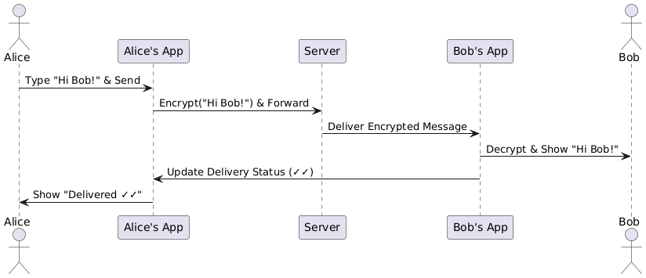
Graphical notations
A graphical language, supplemented by text annotations is used to define the functional requirements for the system. An early example of such a graphical language was SADT (Ross, 1977) (SChoman and Ross, 19n). Now, use-case descriptions (Jacobsen, et 411., 1993) and sequence diagrams are commonly used (Stevens and Pooley, 1999).

Slide 54
Graphical notations
A graphical language, supplemented by text annotations is used to define the functional requirements for the system. An early example of such a graphical language was SADT (Ross, 1977) (SChoman and Ross, 19n). Now, use-case descriptions (Jacobsen, et 411., 1993) and sequence diagrams are commonly used (Stevens and Pooley, 1999).

Slide 55
Mathematical specifications
These are notations based on mathematical concepts such as finite-state machines or sets. These unambiguous specifications reduce the arguments between customer and contractor about system functionality. However, most customers don't understand formal specifications and are reluctant to accept it as a system contract.
States:
S1 = Message Typed
S2 = Message Sent
S3 = Message Delivered
S4 = Message Read
Transitions:
δ(S1, pressSend) → S2
δ(S2, serverAck) → S3
δ(S3, recipientRead) → S4
Here, δ is a state transition function (common in finite-state machines).

Slide 56
Mathematical specifications
These are notations based on mathematical concepts such as finite-state machines or sets. These unambiguous specifications reduce the arguments between customer and contractor about system functionality. However, most customers don't understand formal specifications and are reluctant to accept it as a system contract.
States:
S1 = Message Typed
S2 = Message Sent
S3 = Message Delivered
S4 = Message Read
Transitions:
δ(S1, pressSend) → S2
δ(S2, serverAck) → S3
δ(S3, recipientRead) → S4
Here, δ is a state transition function (common in finite-state machines).

Slide 57
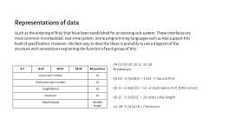
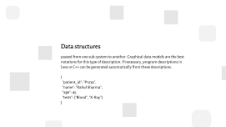
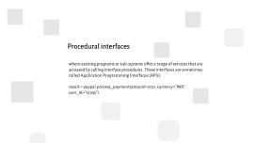
Interface specification
Almost all software systems must operate with existing systems that have already been implemented and installed in an environment. If the new system and the existing systems must work together, the interfaces of existing systems have to be precisely specified. These specifications should be defined early in the process and included in the requirements document. There are three types of interface: that may have to be defined:

Slide 58
Procedural interfaces
where existing programs or sub-systems offer a range of services that are accessed by calling interface procedures. These interfaces are sometimes called Application Programming Interfaces (APls).
result = paypal.process_payment(amount=500, currency="INR", user_id="12345")

Slide 59
Data structures
passed from one sub-system to another. Graphical data models are the best notations for this type of description. If necessary, program descriptions in Java or C++ can be generated automatically from these descriptions.
{
"patient_id": "P1234",
"name": "Rahul Sharma",
"age": 45,
"tests": ["Blood", "X-Ray"]
}

Slide 60
Representations of data
(such as the ordering of bits) that have been established for an existing sub-system. These interfaces are most common in embedded, real-time system. Some programming languages such as Ada support this level of specification. However, the best way to describe these is probably to use a diagram of the structure with annotations explaining the function of each group of bits.
04 D2 00 35 00 1C 1A 2B
Breakdown:
04 D2 → 0x04D2 = 1234 → Source Port
00 35 → 0x0035 = 53 → Destination Port (DNS server)
00 1C → 0x001C = 28 bytes total length
1A 2B → 0x1A2B = Checksum
0-7 | 8-15 | 16-23 | 24-31 | Bit positions
Source port number |  |  |  | 16
Destination port number |  |  |  | 16
Length(Bytes) |  |  |  | 16
Checksum |  |  |  | 16
Data(Payload) |  |  |  | Variable length

Slide 61
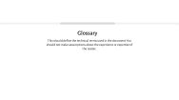





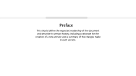



Structure of Software Requirement specification(SRS)
The software requirements document (sometimes called the software requirements specification or SRS) is the official statement of what the system developers should implement. It should include both the user requirements for a system and a detailed specification of the system requirements. In some cases, the user and system requirements may be integrated into a single description. In other cases, the user requirements are defined in an introduction to the system requirements specification. If there are a large number of requirements, the detailed system requirements may be presented in a separate document.

Slide 62
Preface
This should define the expected readership of the document and describe its version history, including a rationale for the creation of a new version and a summary of the changes made in each version.

Slide 63
Introduction
This should describe the need for the system. It should briefly describe its functions and explain how it will work with other systems. It should describe how the system fits into the overall business or strategic ,objectives of the organization commissioning the software.

Slide 64
Glossary
This should define the technical terms used in the document You should not make assumptions about the experience or expertise of the reader.

Slide 65
User requirement definition
The service provided for the user and the non-functional system requirements should be described in this section. This description may use natural language, diagrams or other notations that are understandable by customers. Product and process standards which must be followed should be specified.

Slide 66
System architecture
This chapter should present a high-level overview of the anticipated system architecture showing the distribution of functions across system modules. Architectural components that are reused should be highlighted.

Slide 67
System requirement specification
This should describe the functional and non-functional requirements in more detail. If necessary, further detail may also be added to the non-functional requirements, e.g. interfaces to other systems may be defined.

Slide 68
System Model
This should set out one or more system models showing the relationships between the system components and the system and its environment These might be object models, data-flow models and semantic data models.

Slide 69
System Evolution
This should describe the fundamental assumptions on which the system is based and anticipated changes due to hardware evolution, changing user needs, etc.

Slide 70
Appendices
These should provide detailed, specific information which is related to the application which is being developed. Examples of appendices that may be included are hardware and database descriptions. Hardware requirements define the minimal and optimal configurations for the system. Database requirements define the logical organization of the data used by the system and the relationships between data.

Slide 71
Index
several indexes to the document may be included. As well as a normal alphabetic index, there may be an index of diagrams, also index of functions, etc.

